Slide 1
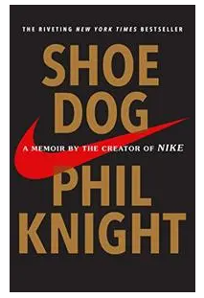
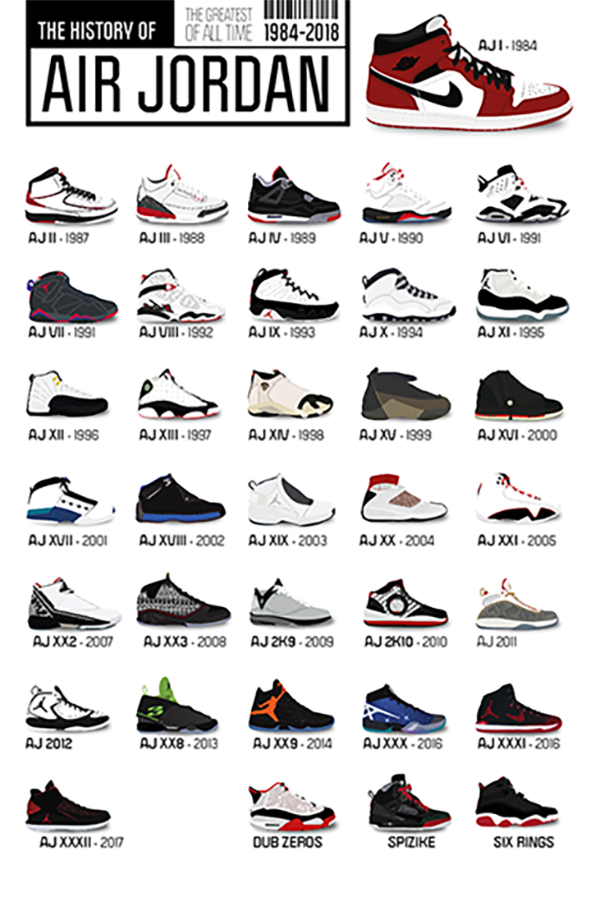
Lessons from Shoe Dog by Phil Knight
“Let everyone else call your idea crazy … just keep going. Don’t stop. Don’t even think about stopping until you get there, and don’t give much thought to where “there” is. Whatever comes, just don’t stop”
--- Phil Knight, Shoe Dog (2016)
“The man who moves a mountain begins by carrying away small stones.”

Slide 2
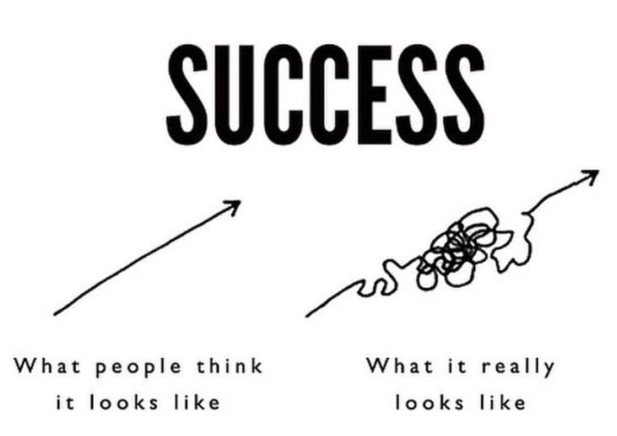
Lesson 1: Formalized education and training can make you a linear thinker. Remember that success and reality are nonlinear.
“Life is Growth. You grow or you die.”

Slide 3
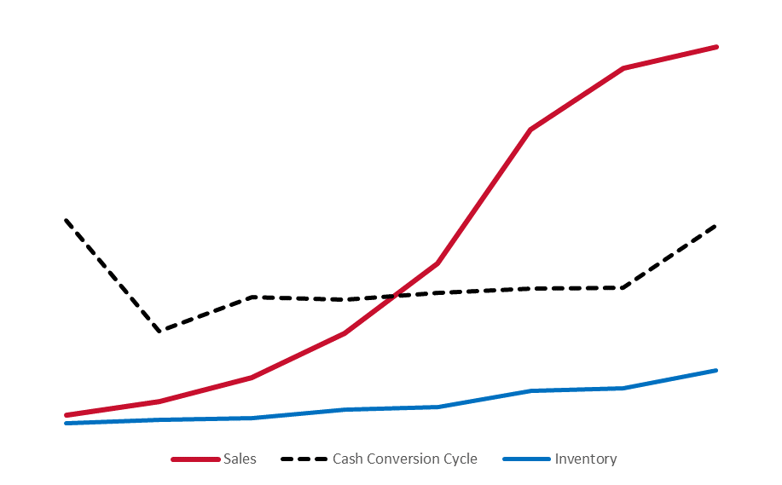
Lesson 2: Cash in a growth business is a “forever” problem. Every penny you make is reinvested back into the business, and you will struggle to make every single payment and live on the float.
Nike was doubling their sales year-over-year but was still cash-poor. They kept borrowing every nickel they could to plow it into growth.
“Despite our fears, the risks and downsides, going public was the best way to fix our cash problem and sustain growth.”

Slide 4
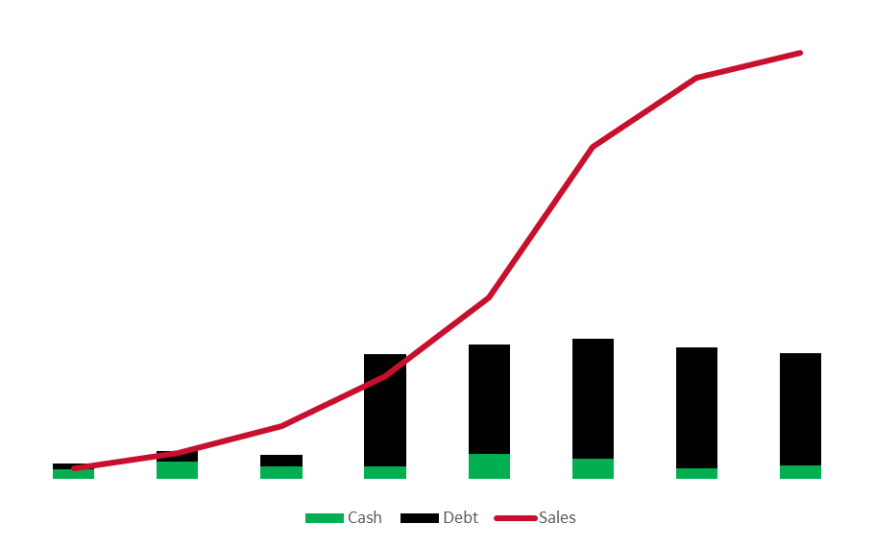
Lesson 3: ALWAYS, ALWAYS, pay your banker no matter what.
As Nike sales ramped they incurred an explosion in assets, and inventory which put tremendous stress on their cash reserves.
During their growth phase, they had a debt to equity as high as 9x.
“We had to figure out how to significantly boost supply without taking on huge inventory risks.”

Slide 5
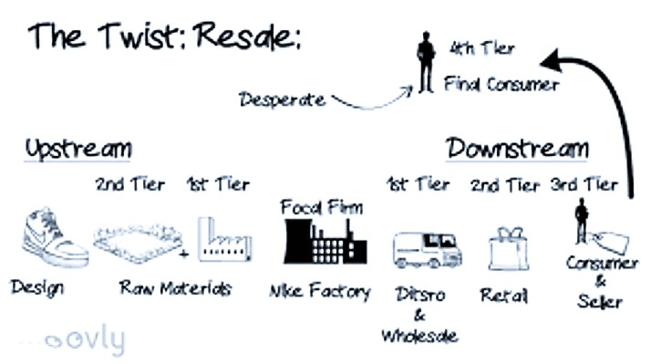
Lesson 4: Supply and demand are the root problem in business regardless of the industry.
It’s hard enough to invent and manufacture and market a product, but then logistics, the mechanics, the hydraulics of getting it to the people who want it, when they want it – this is how companies die
“You are remembered for the rules you break.”

Slide 6
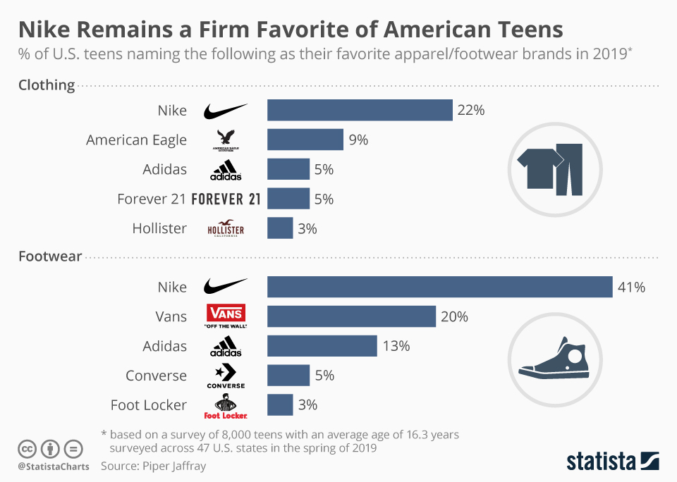
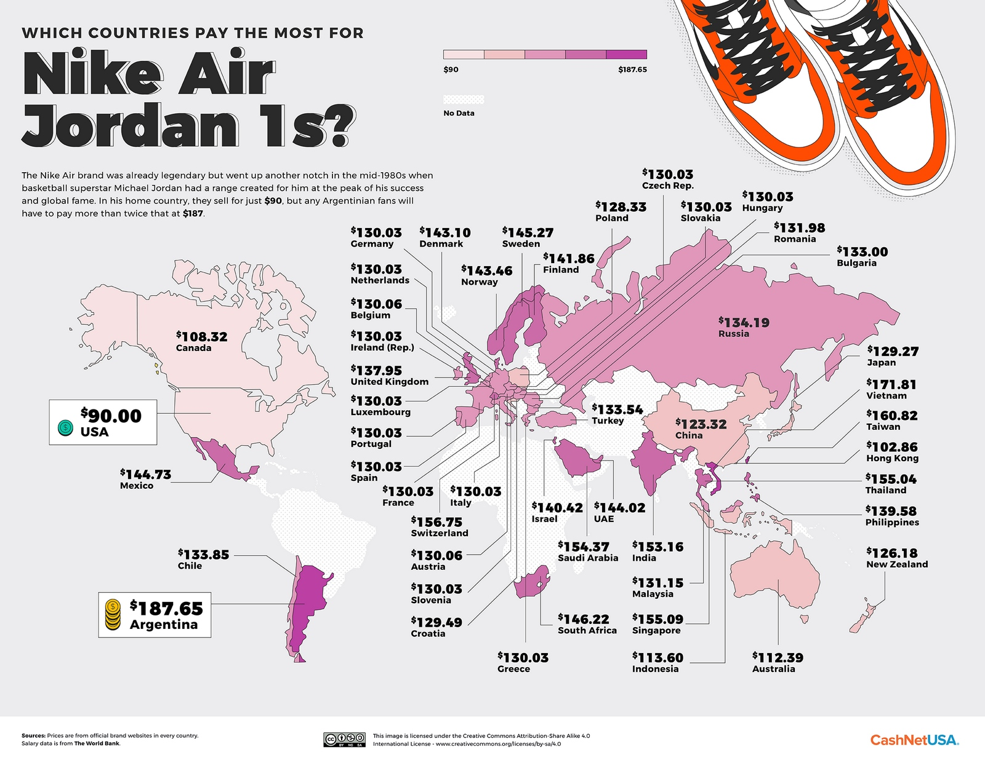
Lesson 5: Beating the competition is relatively easy. Beating yourself is a never-ending commitment.
Adidas was the 800-pound gorilla that possessed all the arrogance of a company that had unchallenged dominance of the marketplace.
Oh, how things have changed.
“Don’t dare feel sorry for me. I’m here to kill you.”

