Slide 1
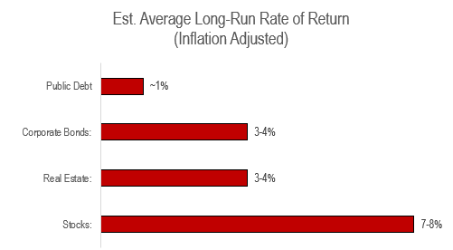
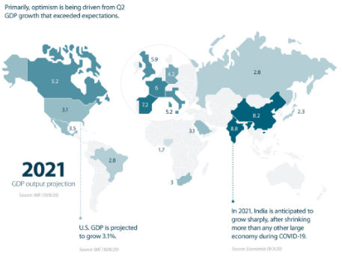
Is r > g the Central Contradiction of Capitalism? Thomas Piketty thinks so
r > g is the Fundamental Force of Divergence in Wealth. In plain speak, r > g means the returns on capital (r) will grow faster than the economy (g). This will thus cause wealth gaps over time
  r = avg. annual rate of return on capital and comes in the form of profits, dividends, interest, rents, and other income.
  g = the rate of growth of the economy. Historically, growth has needed to be at least 3% to maintain a natural rate of unemployment. Piketty predicts this will fall to 1.5%.
Conclusion: in slow growing economies, past wealth naturally takes on larger importance, because it takes only a small flow of new savings to increase the stock of wealth steadily

Slide 2
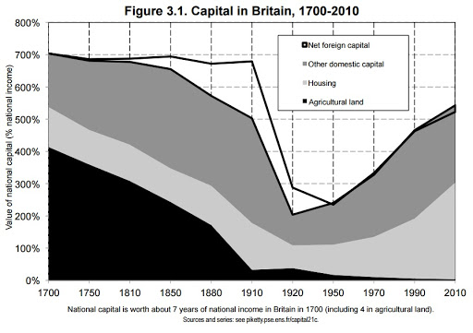
Thomas Piketty’s First Fundamental Law of Capitalism: α = r x β
In plain speak, the First Fundamental Law of Capitalism shows how important capital is in relation to income. For example, if β = 600% and r = 5%, then α = 30%. So put even simpler, capital generates 30% of total income in this hypothetical economy.
Using Britain, you can see that capital’s share of income has fluctuated from highs of 35% down to lows of 10%.
Conclusion:
Although the nature of wealth over the long run has transformed (capital in the form of agriculture has been replaced by industrial, financial capital, and urban real estate), it’s importance as measured by β has remained unchanged.
Remember:
r = avg. annual rate of return on capital. Stocks generate 7-8% while corporate bonds generate 3-4%
β = capital/income ratio. 600% is equivalent to 6 years
α = share of income from capital

Slide 3
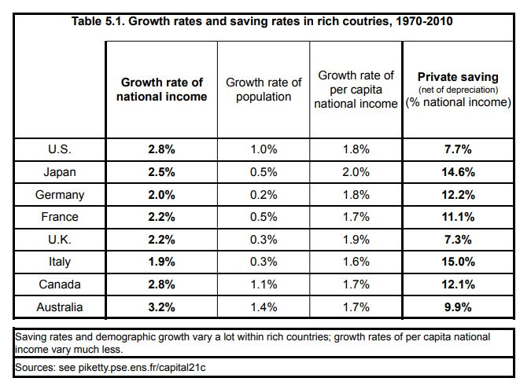
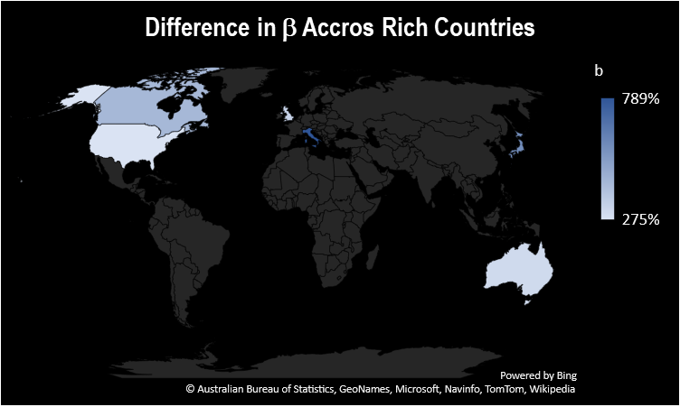
Thomas Piketty’s Second Fundamental Law of Capitalism: β = s / g
In plain speak, the Second Fundamental Law of Capitalism shows that a country with a high savings rate and a low growth rate accumulate an enormous stock of capital relative to its income over the long run. This can have significant effects on the social structure and distribution of wealth.
Conclusion:
The differences in growth rates have enormous effects on the long-run accumulation of capital and largely explain why the capital/income ratio (β) is structurally higher in Europe and Japan than in the U.S.
Remember:
s = savings rate.
β = capital/income ratio. 789% is equivalent to 7.89 years
g = the rate of growth of the economy. Remember this is split between population growth and output growth

Slide 4
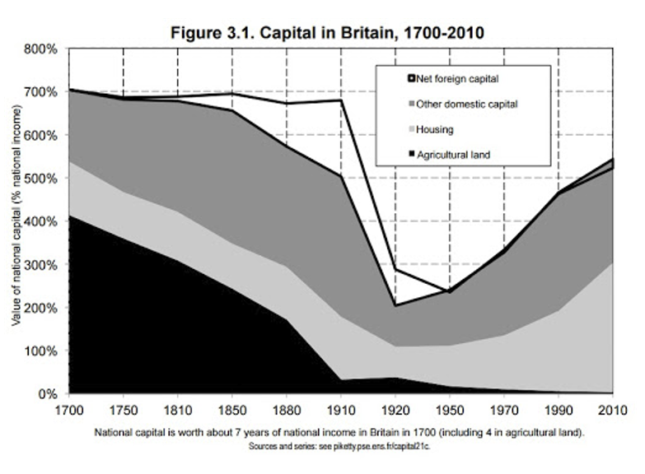
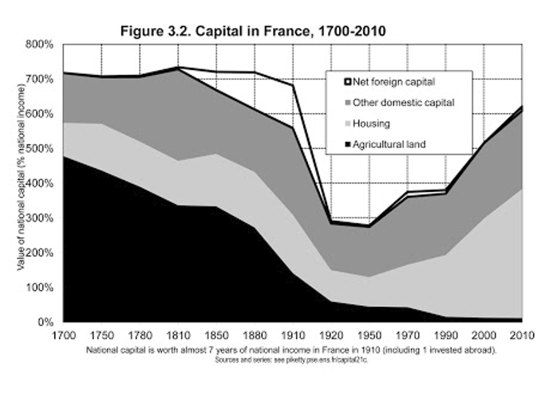
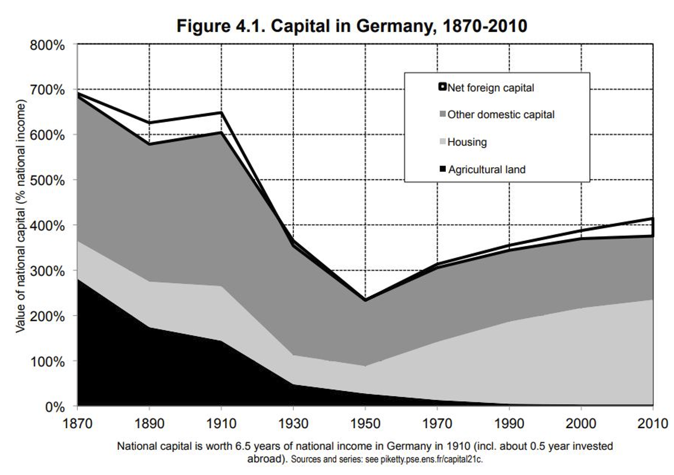
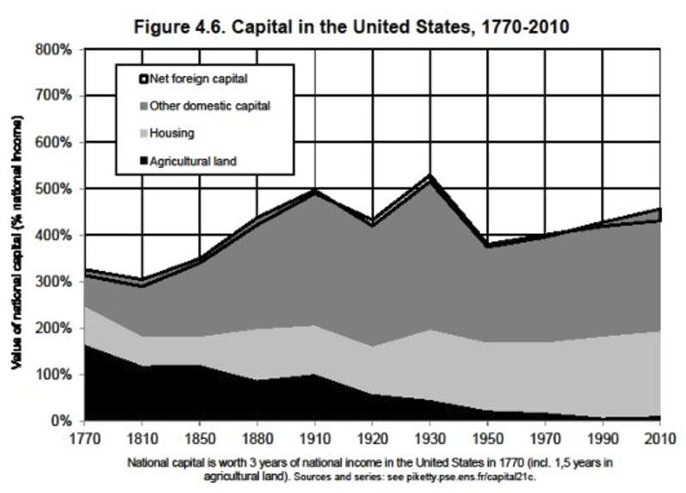
The Dynamics of the Capital/Income Ratio (β) in Europe and the U.S.
National capital = farmland + housing + other domestic capital + net foreign capital
Capital is never quiet: it is always risk-oriented and entrepreneurial, yet it always tends to transform itself into rents as it accumulates in large enough amounts.
Consistent in all rich countries, the nature of capital has changed: it once was mainly land but has become primarily housing plus industrial and financial assets.
  To put it simply, we can see that over the very long run, agricultural land has gradually been replaced by building, business capital, and financial capital invested in firms and government organizations
In terms of asset structure, 21st century capital has little in common with 18th century capital

Slide 5
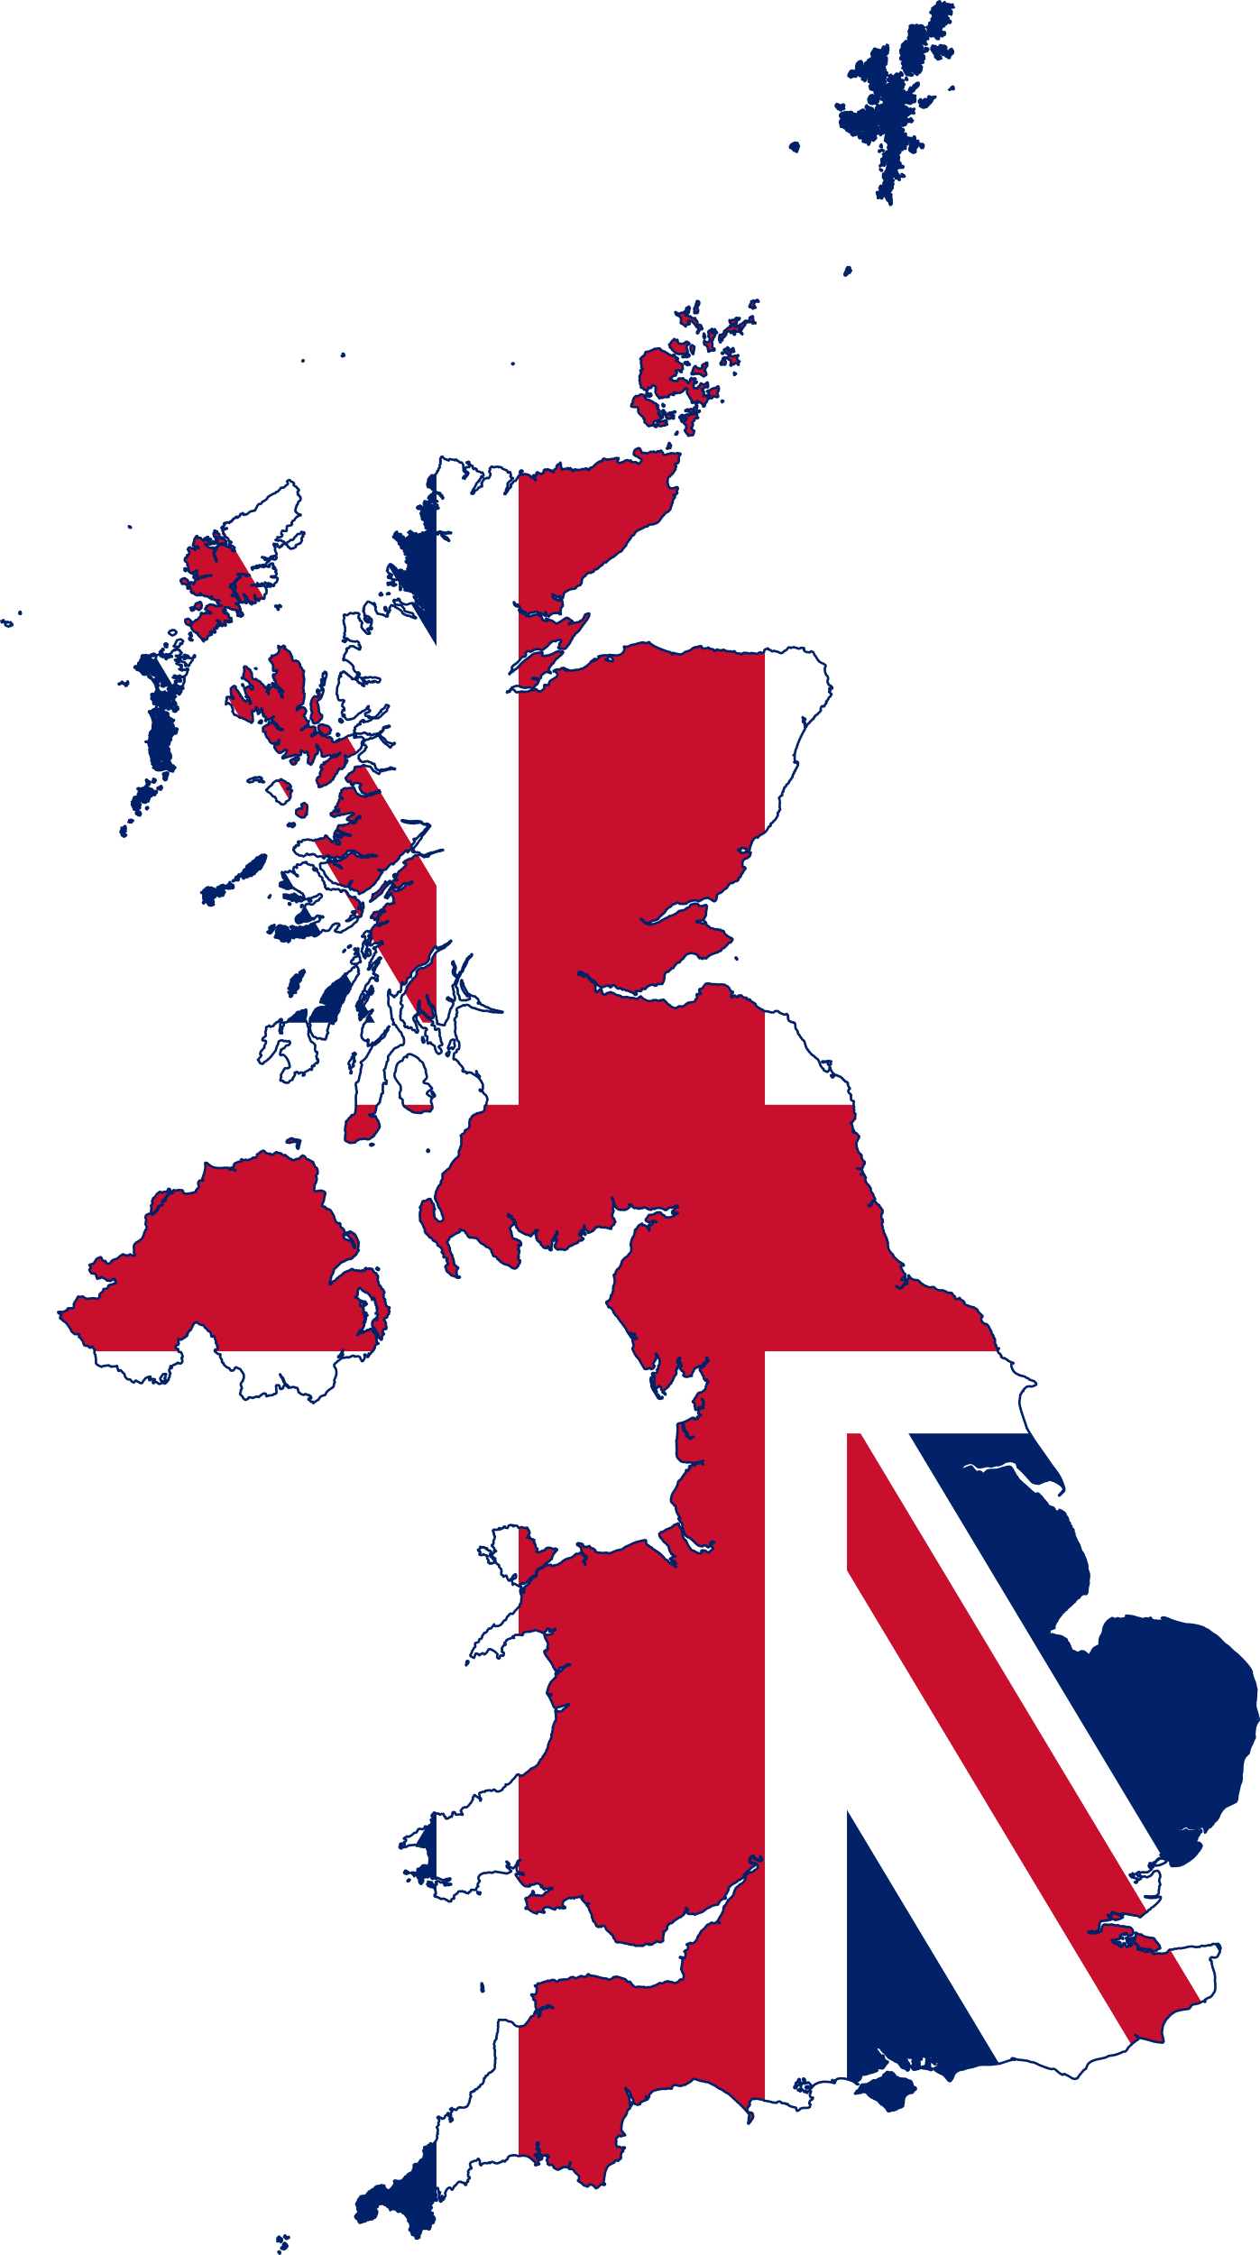
The Capital/Income Ratio (β) in Britain: Public Debt and the Reinforcement of Private Capital
Summary:
There is no doubt that Britain in the 1990s and 2000s regained a level of wealth not seen since the early 20th century.
There is no doubt that Britain’s high level of public debt enhanced the influence of private wealth in British society.
  Interest on British government bonds supplemented land rents as private capital grew to dimensions never before seen
Inflation was virtually zero from 1815 to 1914 and the interest rate on government bonds was generally around 4-5%.
  Investing in public debt was very good business for wealthy people and their heir
In the 19th and 20th century, lenders were handsomely reimbursed as debt was drowned by inflation and repaid with money of decreasing value
Crucial Fact:
Private wealth in 2010 accounts for 99% of national wealth in Britain. The bulk of the public debt in practice was owned by a minority of the population.

Slide 6

The Capital/Income Ratio (β) in France: A Capitalism without Capitalists
Summary:
There is no doubt that Britain in the 1990s and 2000s regained a level of wealth not seen since the early 20th century.
The French story is an accumulation of significant public assets in the industrial and financial sectors in the period of 1950-1980, followed by major waves of privatization of the same assets after 1980
France has a mixed economy: in a sense a capitalism without capitalists, or at any rate a state capitalism in which private owners no longer control the largest firms
War, Great Depression, and general ruin of the masses caused people to question private capitalism in favor of more nationalism in France compared to the rest of Europe
Crucial Fact:
Private wealth in 2010 accounts for 95% of national wealth in France.

Slide 7

The Capital/Income Ratio (β) in Germany: Rhenish Capitalism and Social Ownership
Summary:
The character of Rhenish capitalism or stakeholder model is a model in which firms are owned not only by shareholders but also by certain other interested parties like the firms’ workers themselves
  This model results in lower valuations of German firms
Germany made the most dramatic use of inflation to rid itself of debt in the 20th century.
Germany currently refuses to countenance any rise in prices greater than 2% a year
Biggest difference between Germany and Britain & France is the difference in the value of other domestic capital, and primarily capital of firms.
Crucial Fact:
Firms in Germany have a lower stock market valuation than firms in Britain & France.

Slide 8

The Capital/Income Ratio (β) in The U.S.: More Stable Than in Europe
Summary:
Make no mistake: the low capital/income ratio in America reflected a fundamental difference in the structure of social inequalities compared with Europe
The influence of landlords and accumulated wealth was less important in the New World
Nevertheless the “U-shaped curve” of the capital/income ratio in the 20th century is smaller in amplitude in the United States than in Europe
The United States is more than 95% American owned and less than 5% foreign owned
Crucial Fact:
The crucial point is that the number of hectares per person was obviously far greater in North America than in old Europe.

Slide 9
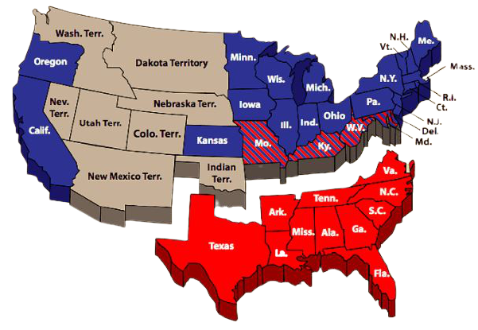
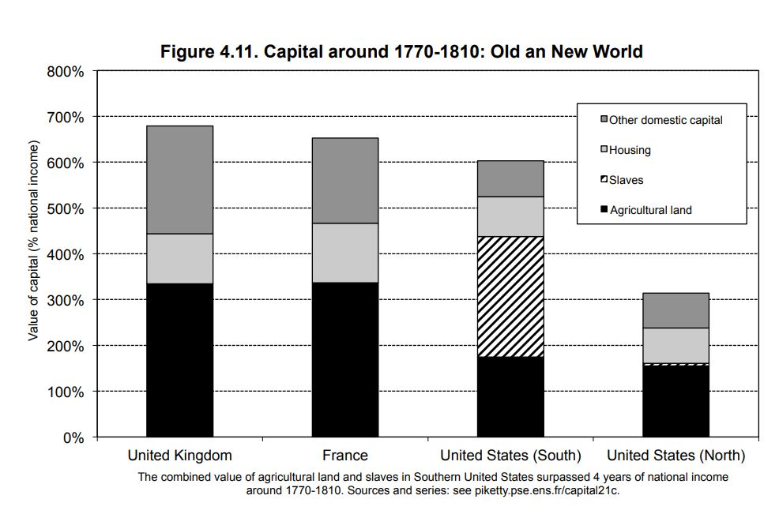
The Capital/Income Ratio (β) in The U.S.: Revisited Through the
Lens of Slavery
Summary:
What one finds when you examine the US through the lens of slavery is that the total market value of slaves represented nearly a year and a half of U.S. national income in the late 18th century and the first half of the 19th century
  This is roughly equal to the total value of farmland
In the American South, the total value of slaves ranged between two and a half and three years of national income, so that the combined value of farmland and slaves exceed four years of national income.
In the South, we find a world where inequalities of ownership took the most extreme and violent form possible, since one half of the population owned the other half.
The complex and contradictory relation of inequality largely persists in the U.S. to this day:
  On the one hand this is a country of egalitarian promise, a land of opportunity for millions of immigrants of modest background
  On the other hand it is a land of extremely brutal inequality, especially in relation to race, whose effects are still quite visible
Crucial Fact:
Their farmland was not worth very much, but they had the bright idea of owning not just the land but also the labor force needed to work that land.

Slide 10
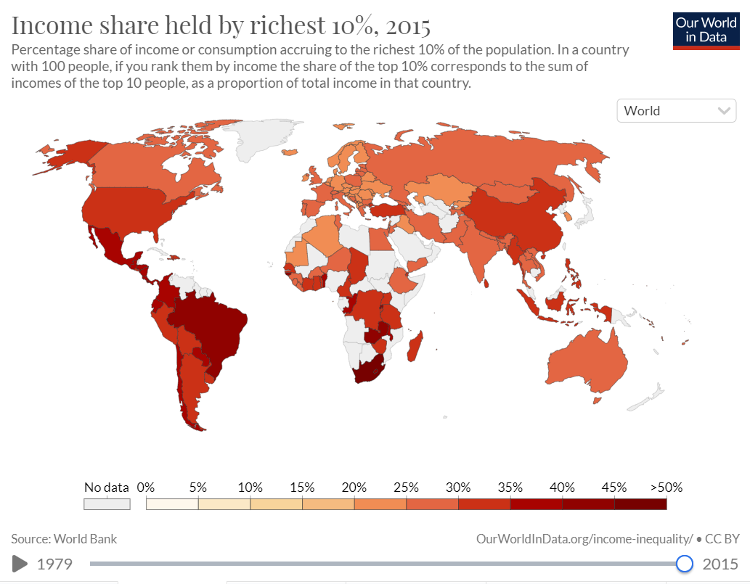
The Structure of Inequality
In all societies, income inequality can be decomposed into three terms:
  Inequality in income from labor
  Inequality in the ownership of capital and the income to which it gives rise
  Interaction between these two terms
Crucial Facts:
In most inegalitarian countries, such as the United States in early 2010s where income from labor is about as unequally distributed as has ever been observed anywhere, the top decile gets 35% of the total, whereas the bottom half gets only 25%.
In the most egalitarian countries, the bottom 50% receive nearly twice as much total income as the top 10%
Inequalities with respect to capital ownership is extremely inegalitarian everywhere in the world.
The 1% who earn the most are not the same as the 1% who own the most.
Notes:
https://ourworldindata.org/income-inequality

Slide 11


Two Types of Hyper-Inegalitarian Societies
Thomas Piketty stresses two types of hyper-inegalitarian societies that can achieve high levels of income inequality:
1. Society of rentiers (hyper patrimonial society)
2. Society of super managers (hyper meritocratic society)
A society in which inherited wealth is very important and where the concentration of wealth attains extreme levels.
Think Bridgeton and Europe
The society of super managers is relatively new and was largely created by the United States over the past few decades.
Think Mad Men and the United States
Critical Fact:
Patrimonial capitalism is in large part a repetition of the past and characteristic of low growth environments of the 19th century.
Critical Fact:
The peak of the income hierarchy is dominated by very high incomes from labor rather than by inherited wealth
Notes:
https://ourworldindata.org/income-inequality

Slide 12
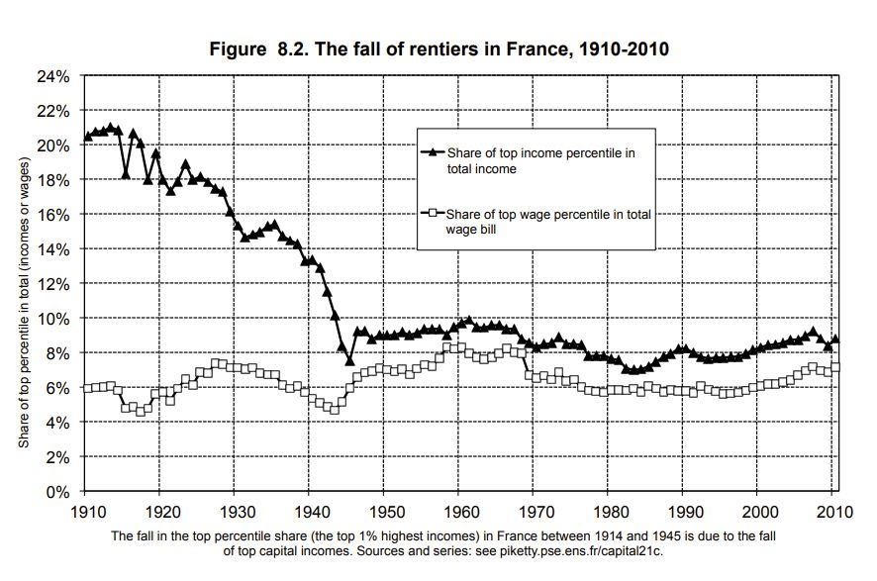
The Reduction of Inequality in France in the 20th Century: The Fall of Rentiers
Summary:
Income inequality has greatly diminished in France since the Belle Époque:
  The upper decile’s share of national income decreased from 45-50% on the eve of World War I to 30-35% today.
In the 20th century it was war, and not harmonious democratic or economic rationality, that erased the past and enabled society to begin anew with a clean slate.
  In wartime, economic activity decreases, inflation increases, and real wages/purchasing power begins to fall
The reduction of inequality in France during the 20th century is largely explained by the fall of the rentier and the collapse of very high incomes from capital.
Note that the share of top wage (income from labor) remained relatively unchanged.
Crucial Fact:
The Belle Époque society was indeed one of the most inegalitarian societies of all time

Slide 13
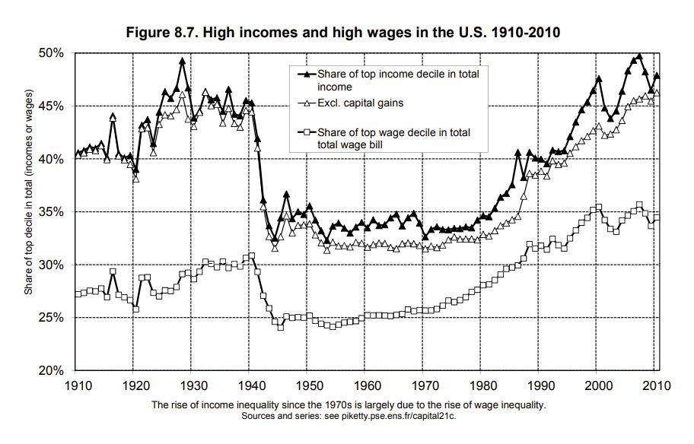
The Transformation of Inequality in the U.S.: The Rise of Super Mangers
Summary:
U.S. inequality in 2010 is quantitatively as extreme as in old Europe in the first decade of the 20th century, but the structure of that inequality is rather clearly different.
Structural inequality of income in the U.S. is only slightly explained by capital gains
  A very substantial and growing inequality of capital income since 1980 accounts for about 33% of the increase in income inequality in the United States
The vast majority (60%-70%) of the top 0.1% of the income hierarchy in 2000-2010 consists of top managers
  By comparison, athletes, actors, and artists of all kinds make up less than 5% of this group
In this sense, the new U.S. inequality has much more to do with the advent of super managers than with that of superstars
Crucial Fact:
Quite clearly that the financial crisis as such cannot be counted on to put an end to the structural increase in inequality in the U.S.

Slide 14
Why Does Inequality of Income from Labor and Capital Occur?

Slide 15

All Things Being Equal, It All Comes Back to the Inequality r > g
r > g is the Fundamental Force of Divergence in Wealth. In plain speak, r > g means that returns to capital will grow faster than the economy and thus will cause inequalities in wealth over time.
  The inequality r > g is the basis of a society of rentiers (hyper patrimonial society)
Regardless of how you get there, once a fortune is established, the capital grows according to a dynamic of its own, and it can continue to grow at a rapid pace for decades simply because of its size.
r > g, combined with the inequality of returns on capital as a function of initial wealth, can lead to excessive and lasting concentrations of capital: no matter how justified inequalities of wealth may be initially, fortunes grow and perpetuate themselves beyond all reasonable limits and beyond any possible rational justification in terms of social utility
Broadly speaking, the central fact is that the return on capital often inextricably combines elements of true entrepreneurial labor (an absolutely indispensable force for economic development) and pure luck (one happens at the right moment to buy a promising asset at a good price).
Modern growth, which is based on the growth of productivity and the diffusion of knowledge, has made it possible to balance the process of capital accumulation. But it has not altered the deep structures of capital – or at any rate has not truly reduced the macroeconomic importance of capital relative to labor.
I don’t envy the challenge we are all about to embark on in regulating capital in the 21st century…

